Slide 1
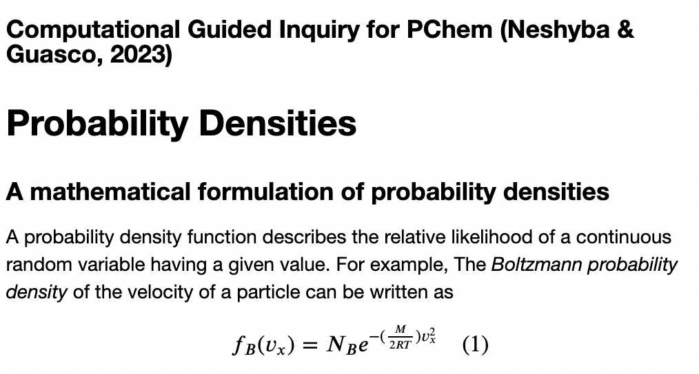
1. The Probability Densities CGI

Slide 2
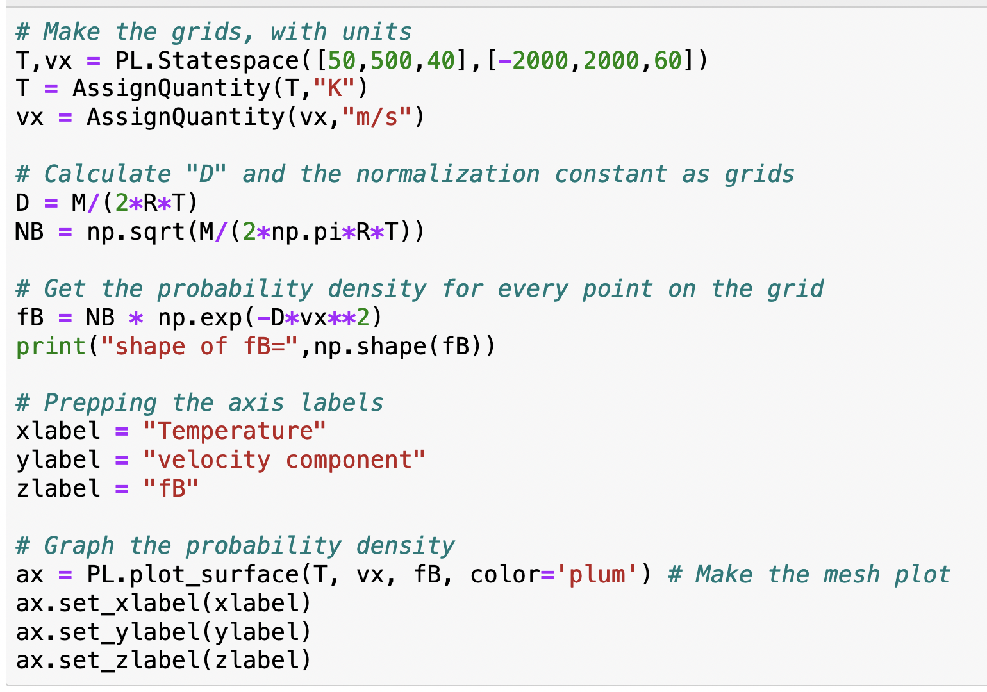
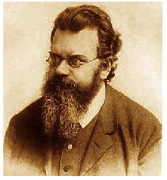
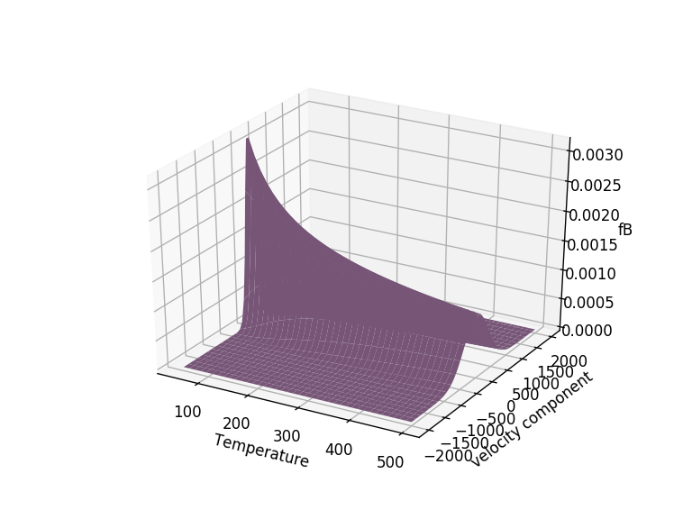
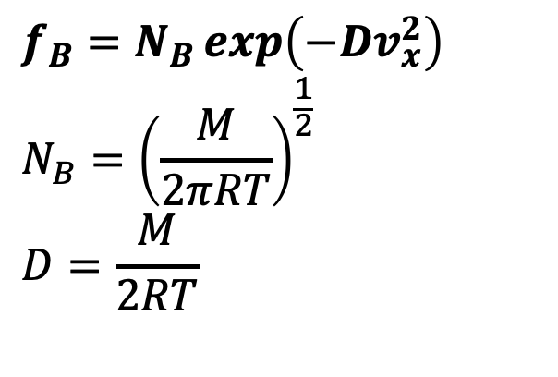
Using Python to visualize $f_{B} (T,v_{x})$ (grid)
$$f_{B}=N_{B}\exp\left(−Dv_{x}^{2}\right)$$
$${N_{B}=\left(\frac{M}{2πRT}\right)}^{\frac{1}{2}}$$
$$D=\frac{M}{2RT}$$

Slide 3
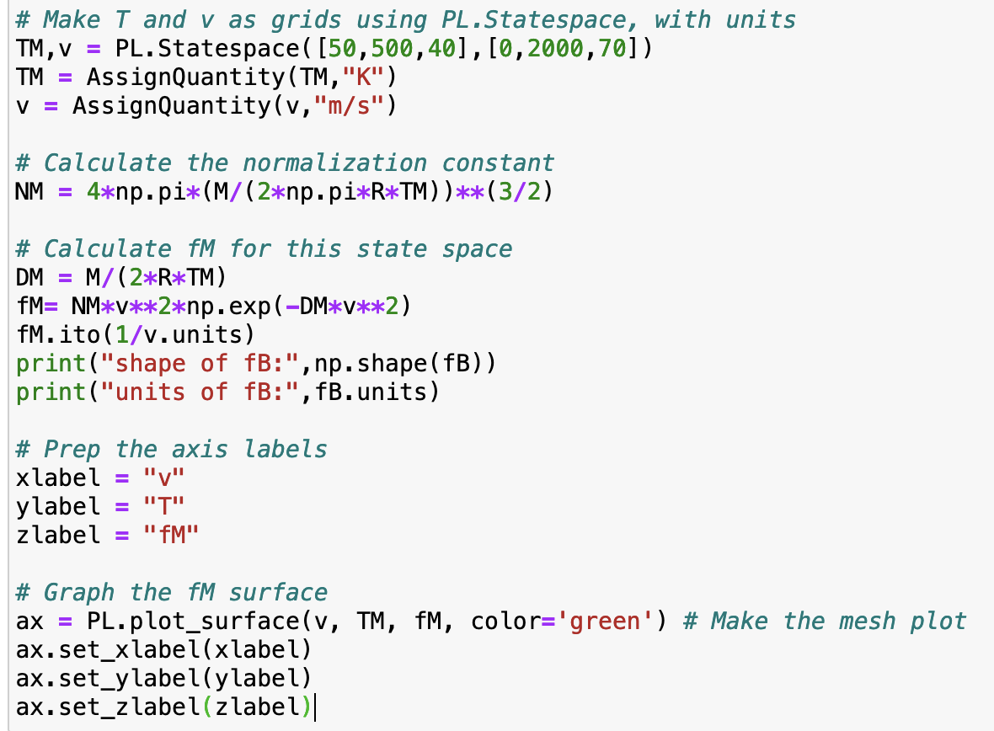
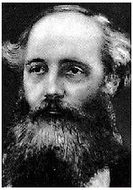
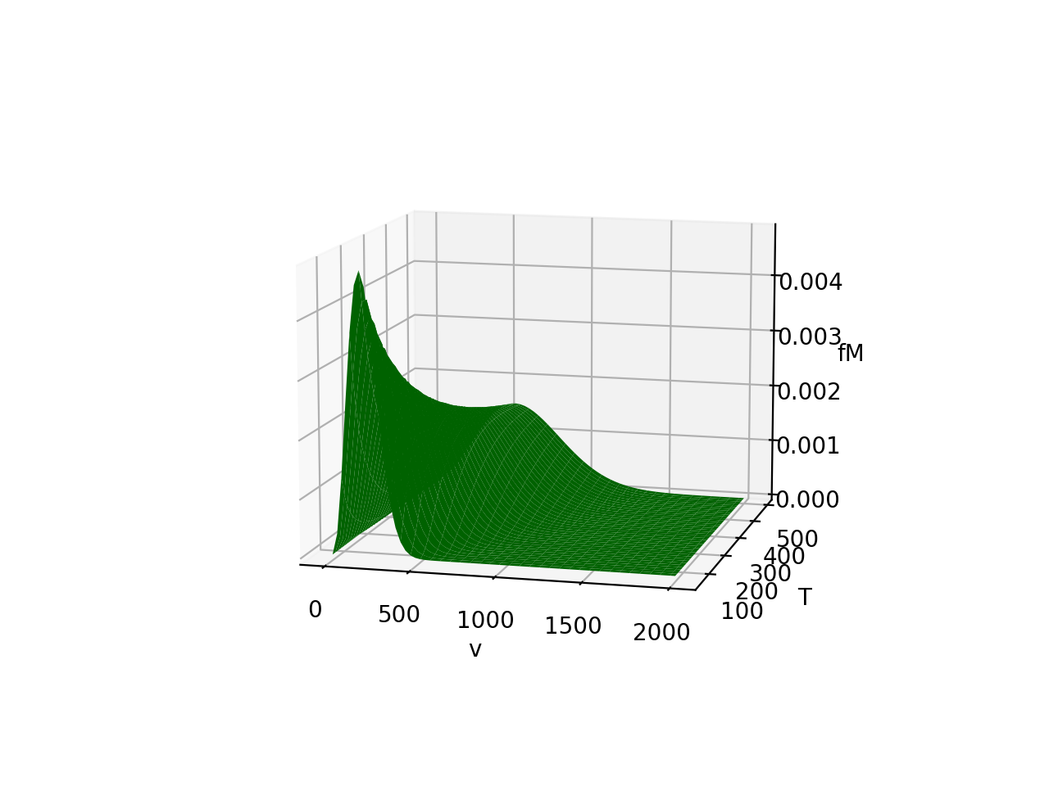
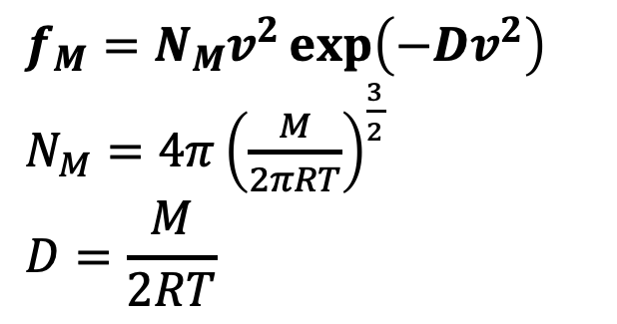
The Maxwell Distribution (which we’re calling “$f_{M}$”)
$$f_{M}=N_{M}v^{2}\exp\left(−Dv^{2}\right)$$
$N_{M}=4π{\left(\frac{M}{2πRT}\right)}^{\frac{3}{2}}$
$$D=\frac{M}{2RT}$$

Slide 4
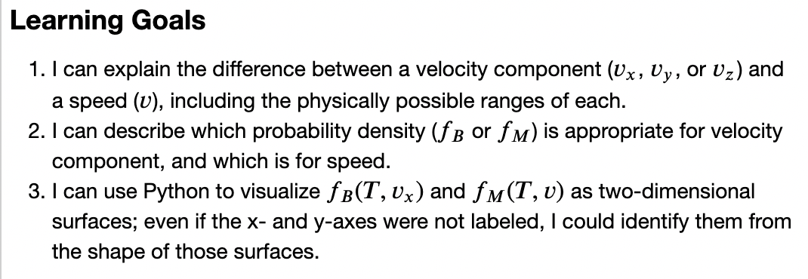
The Probability Densities CGI – Learning goals

Slide 5
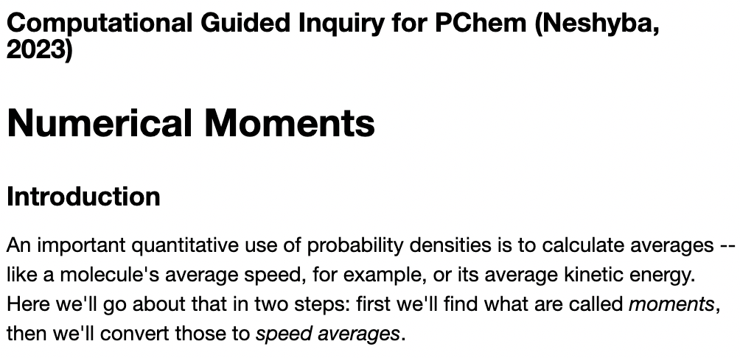
2. The Numerical Moments CGI

Slide 6
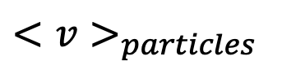
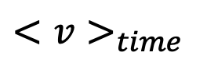
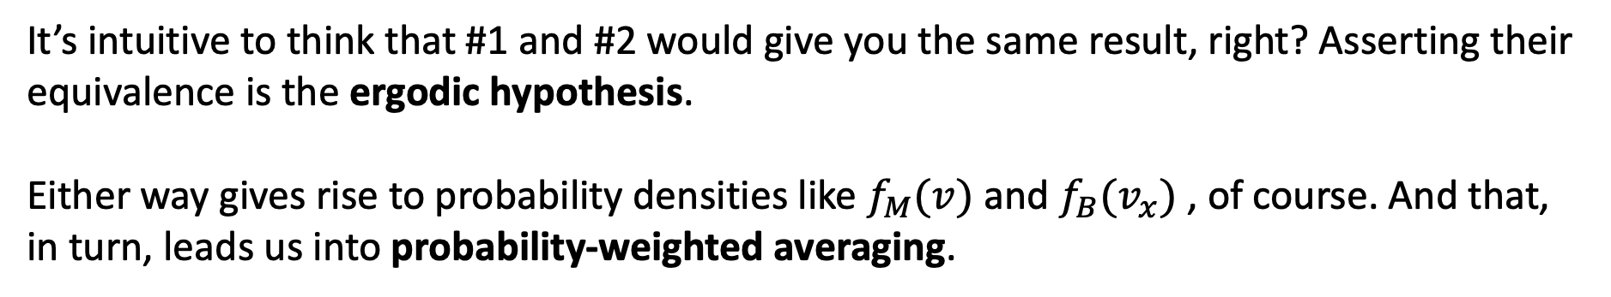
Averages and the Ergodic hypothesis
Thermodynamics offers two different ways to think about averages:
Follow one molecule over time
Take a snapshot of a bunch of molecules at a given instant
$<v>_{time}$
$<v>_{particles}$
It’s intuitive to think that #1 and #2 would give you the same result, right? Asserting their equivalence is the ergodic hypothesis.
Either way gives rise to probability densities like $f_{M}(v)$ and $f_{B}(v_{x})$ , of course. And that, in turn, leads us into probability-weighted averaging.

Slide 7

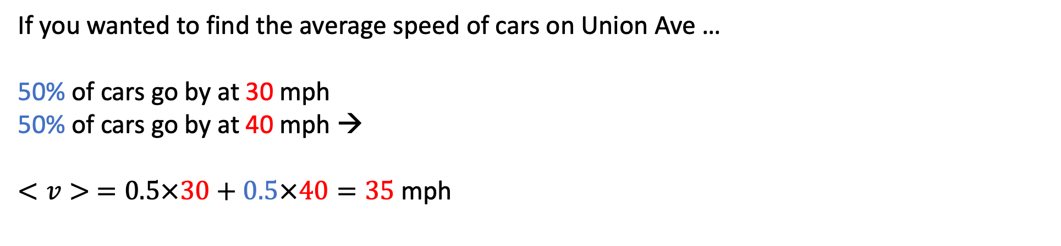
Probability-weighted averaging with two possible speeds
If you wanted to find the average speed of cars on Union Ave …
50% of cars go by at 30 mph
50% of cars go by at 40 mph →
$<v> =0.5×30+0.5×40=35$mph

Slide 8
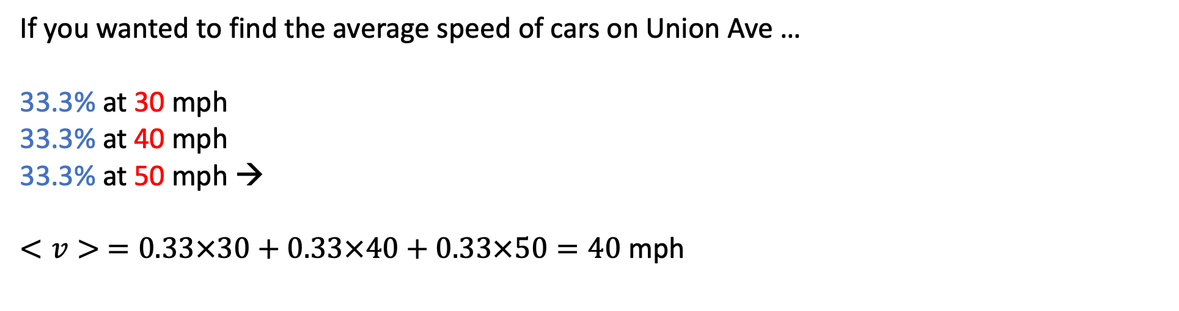
Probability-weighted averaging with three possible speeds
If you wanted to find the average speed of cars on Union Ave …
33.3% at 30 mph
33.3% at 40 mph
33.3% at 50 mph →
$$<v> =0.33×30+0.33×40+0.33×50=40 \text{mph}$$

Slide 9
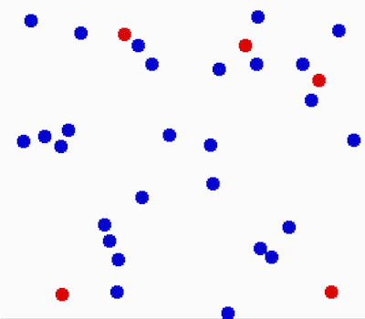
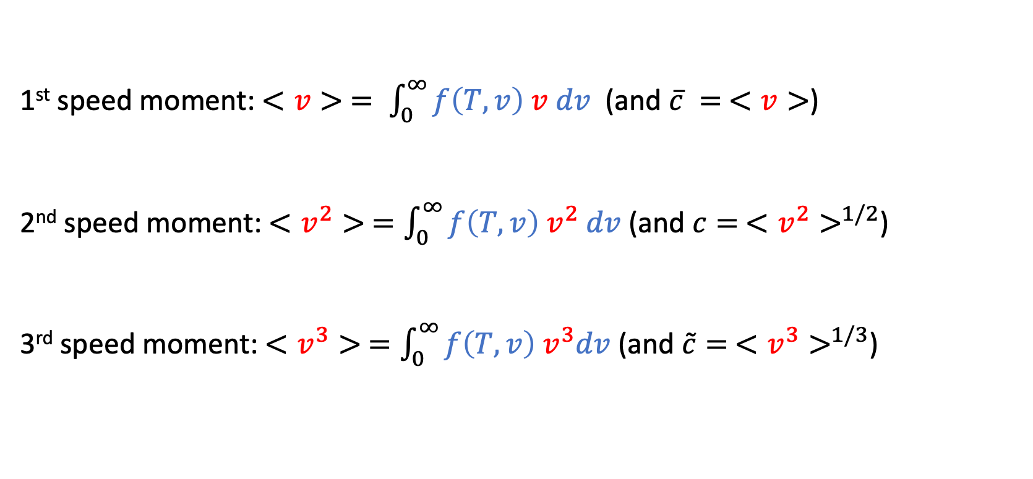
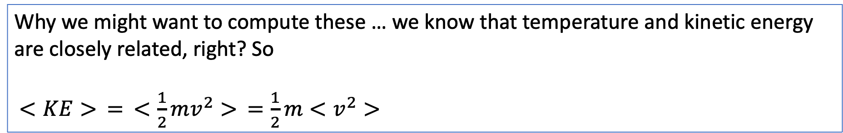
“Speed moments” from probability densities
1st speed moment: $<v> = \int_{0}^{∞}{f\left(T,v\right) v dv}$ (and $\overline{c} = <v>$)
2nd speed moment: $<v^{2}> =\int_{0}^{∞}{f\left(T,v\right) v^{2} dv}$ (and $c= <v^{2}>^{1/2}$)
3rd speed moment: $<v^{3}> =\int_{0}^{∞}{f\left(T,v\right){ v}^{3}dv}$ (and $\tilde{c}= <v^{3}>^{1/3}$)
Why we might want to compute these … we know that temperature and kinetic energy are closely related, right? So
$<KE> = <\frac{1}{2}mv^{2}> =\frac{1}{2}m<v^{2}>$

Slide 10
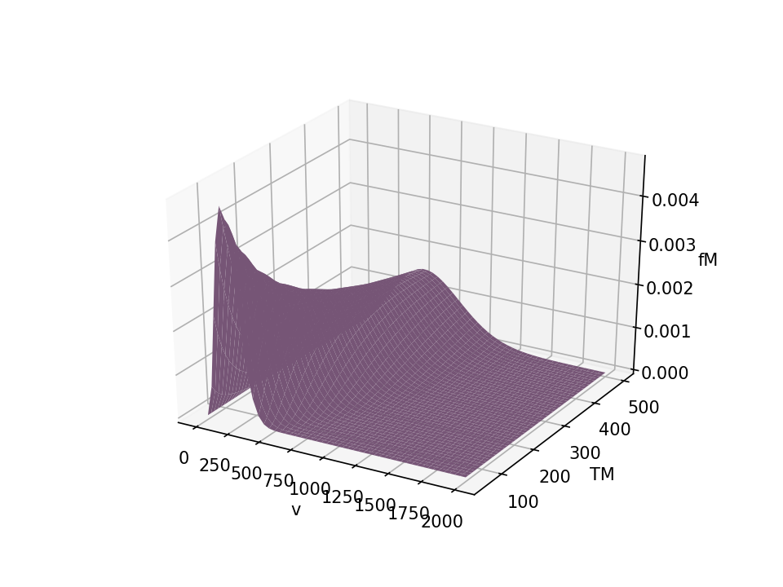
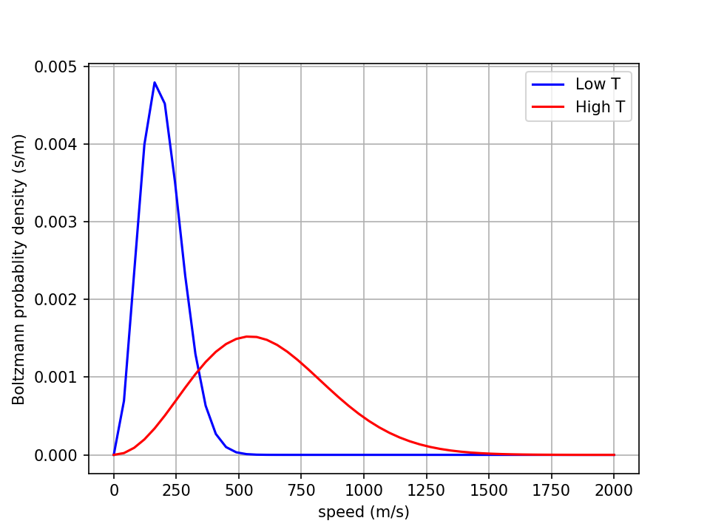
How to get those speed moments? A numerical approach is pretty easy: First we slice …

Slide 11
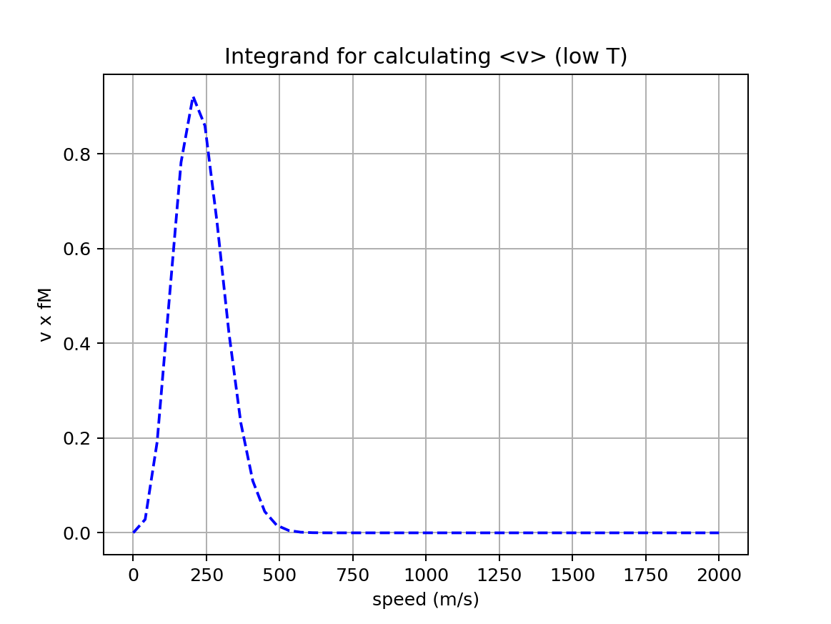
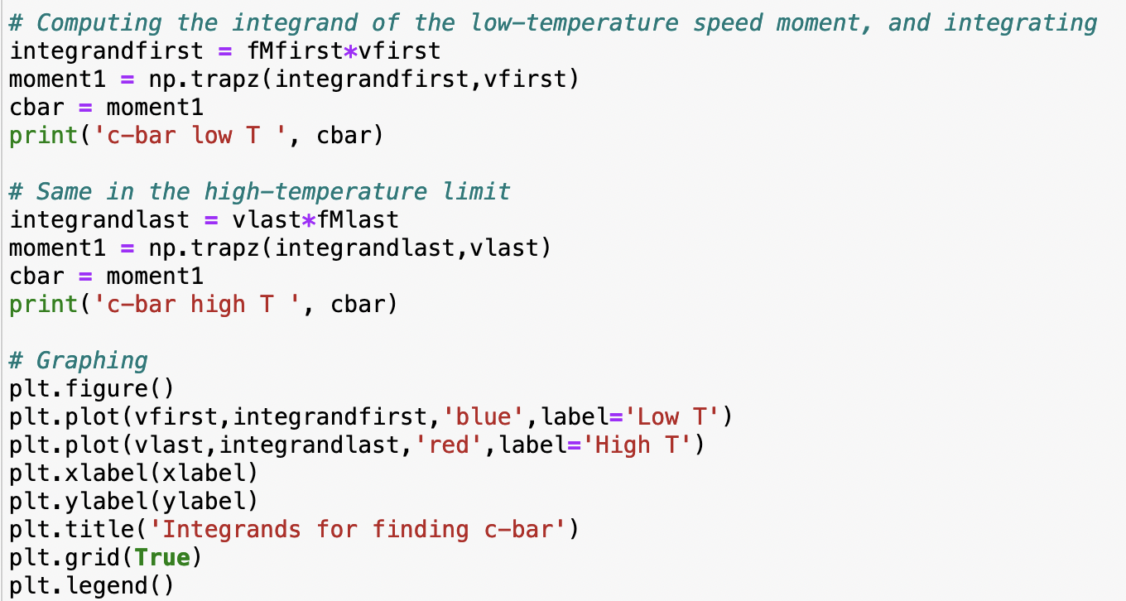
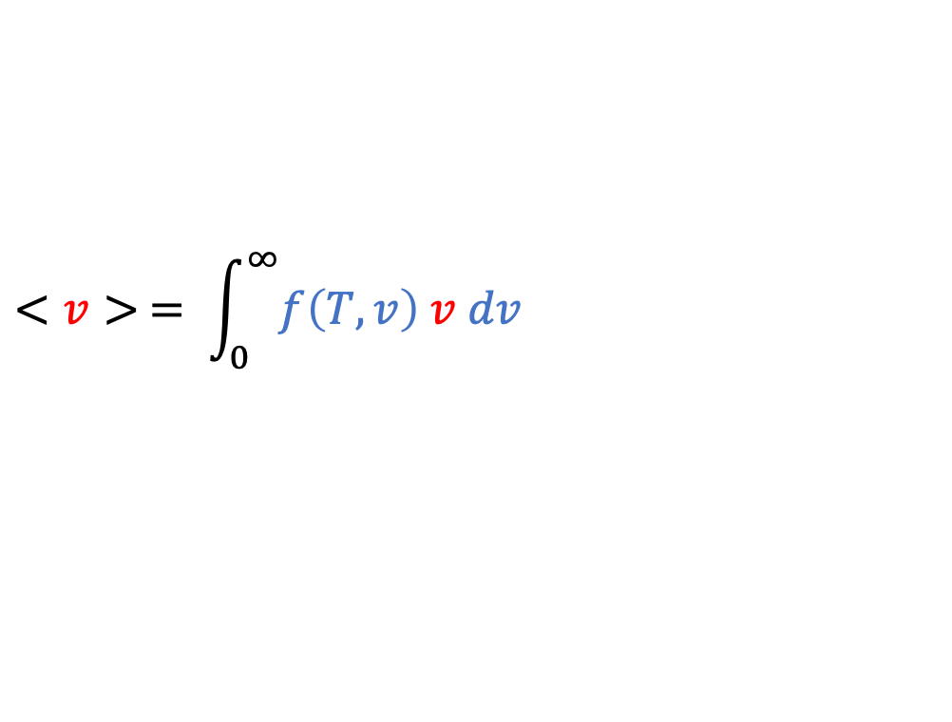
… then we compute and plot the integrand
$$<v> = \int_{0}^{∞}{f\left(T,v\right) v dv}$$

Slide 12
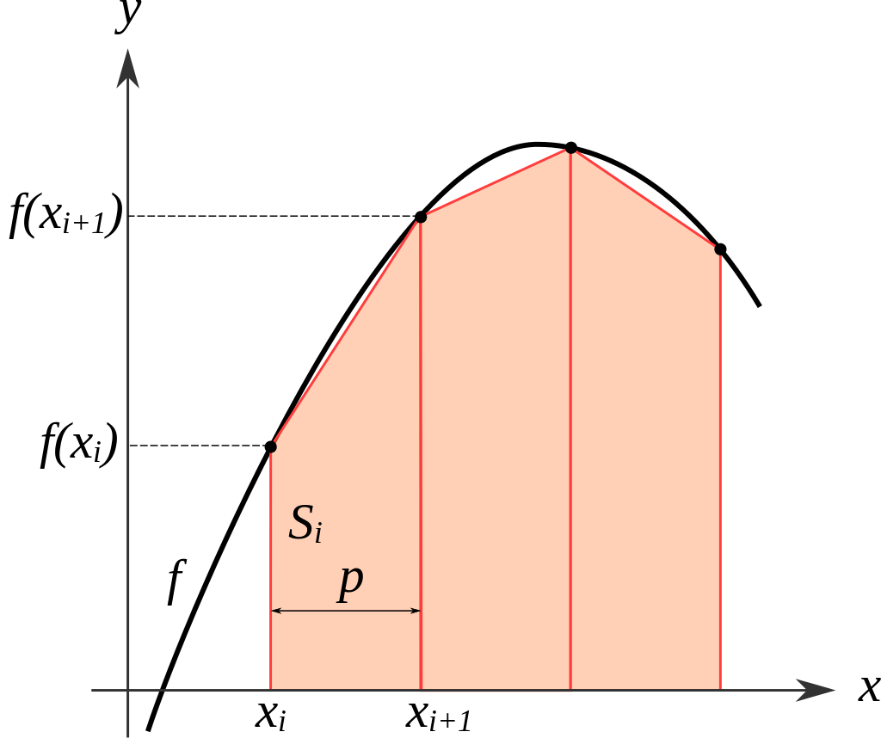

Then we use Python’s trapezoidal rule integrator!
https://en.wikipedia.org/wiki/Trapezoidal_rule
integrand
integral
Generally, the syntax is: Integral = np.trapz(integrand, x)
In our case
“x” will be $v$ (speed) or $v_{x}$ (a velocity component)
The integrand will be $f_{M}\left(T,v\right)$or $f_{B}\left(T,v_{x}\right)$times the quantity you want to average (e.g., $v$, $v^{2}$,$v^{3}$,$v_{x}$, $v_{x}^{2}$, $v_{x}^{3}$)

Slide 13
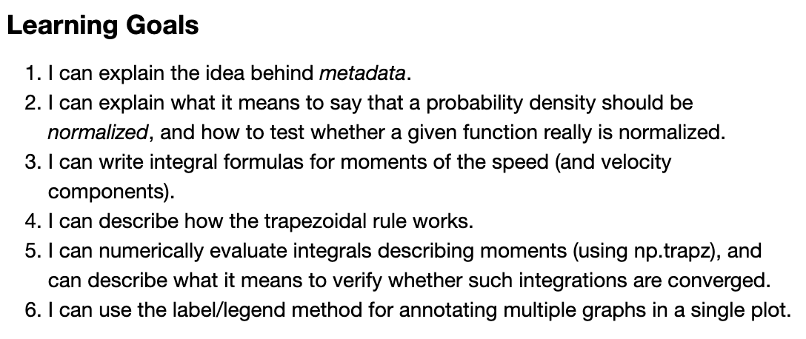
The Numerical Moments CGI – Learning goals

